Slide 1
Stay Savvy
By Tadija, Dago, and Anthony

Slide 2

Who are we?
We are a third-party consulting and management company specializing in helping Airbnb hosts optimize their listings through data-driven insights.

Slide 3
Why this dataset?
Comprehensive overview of Airbnb data
Directly relates to our objectives
Useful field such as:
Price
availability (yearly, monthly, daily…)
Neighborhood
reviews (value, location, communication…)

Slide 4
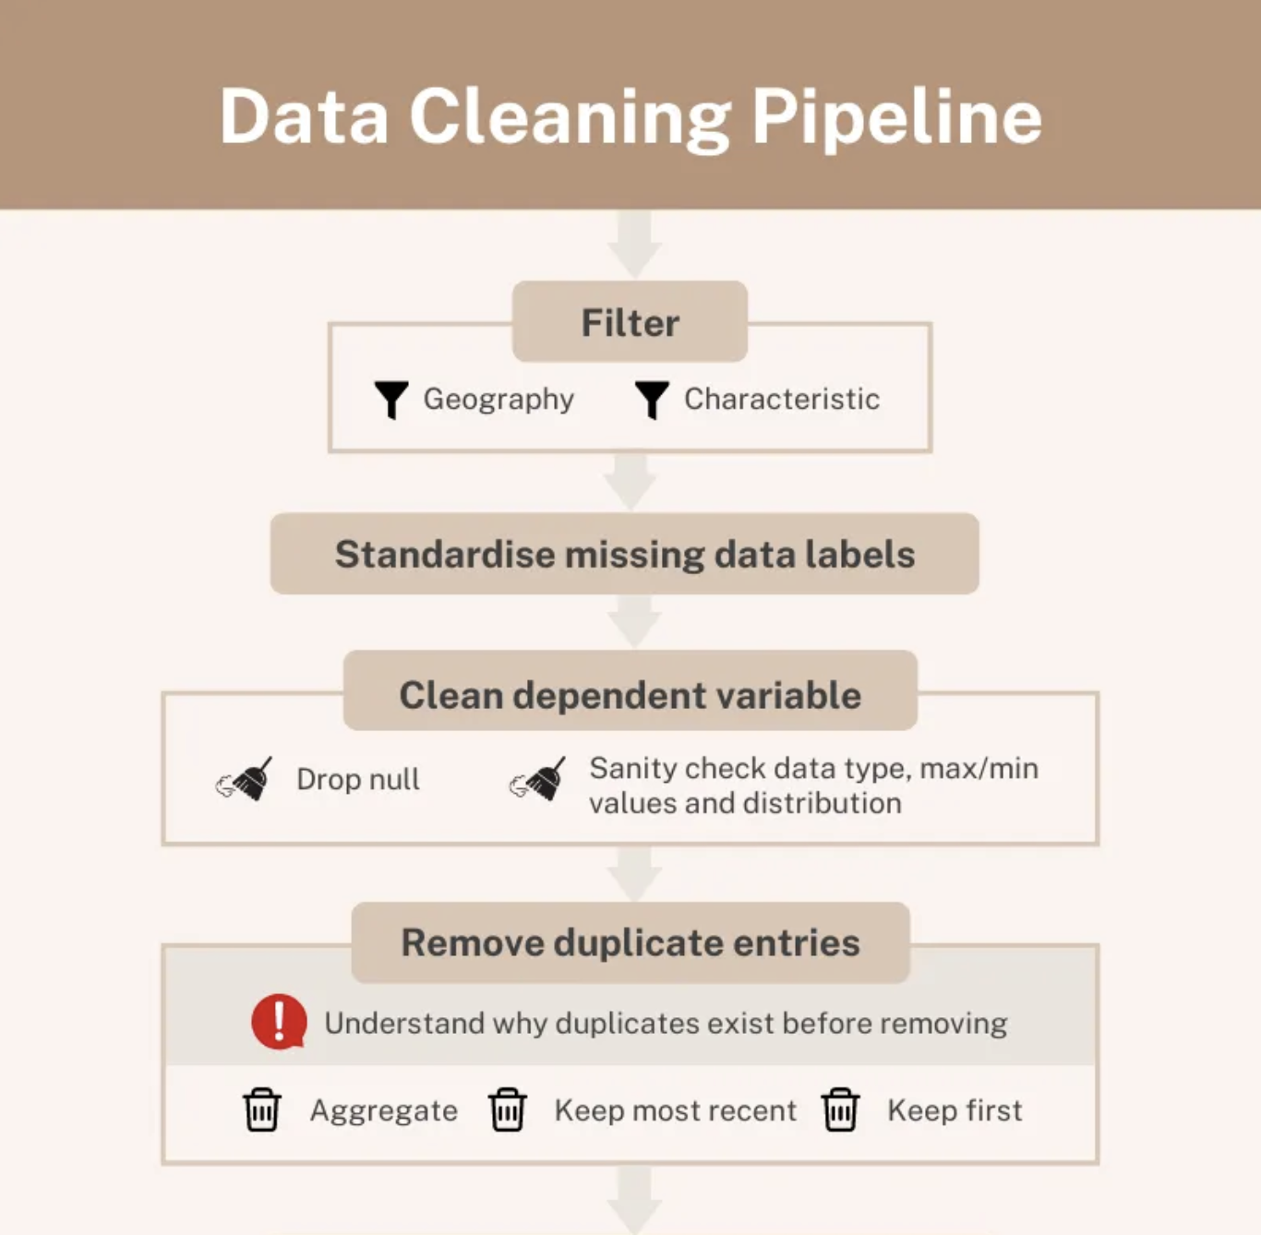
Data Cleaning Process

Slide 5
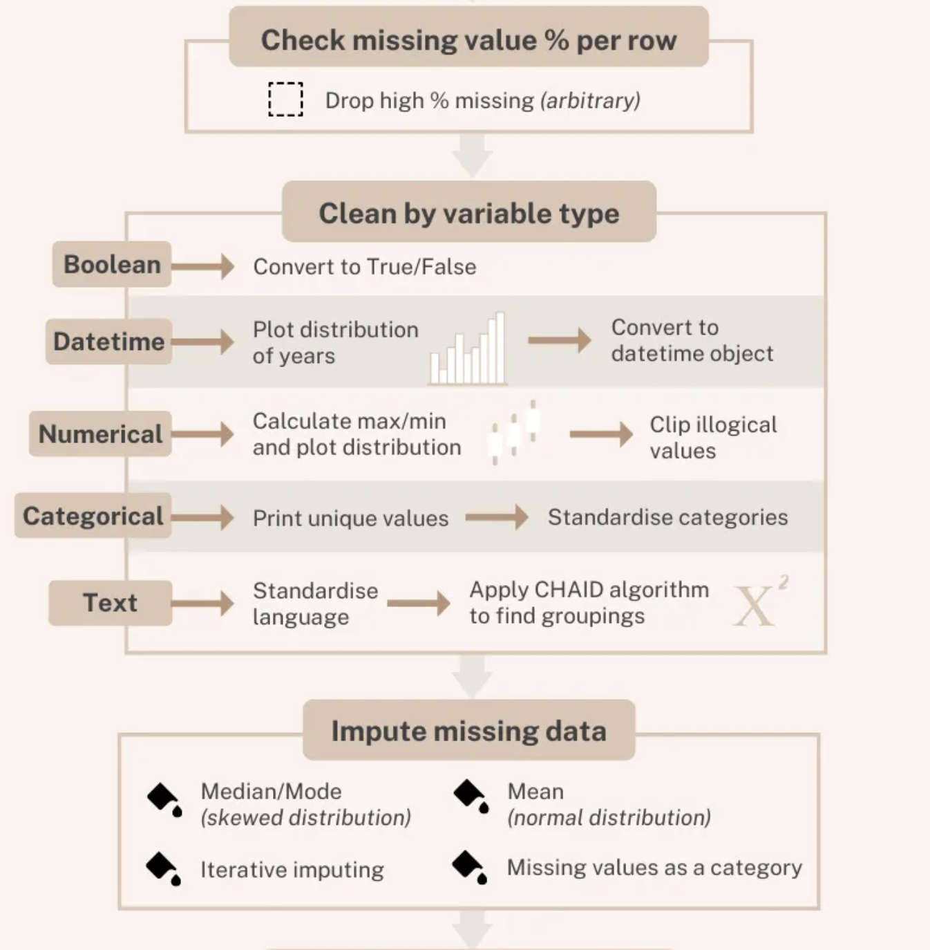

Slide 6
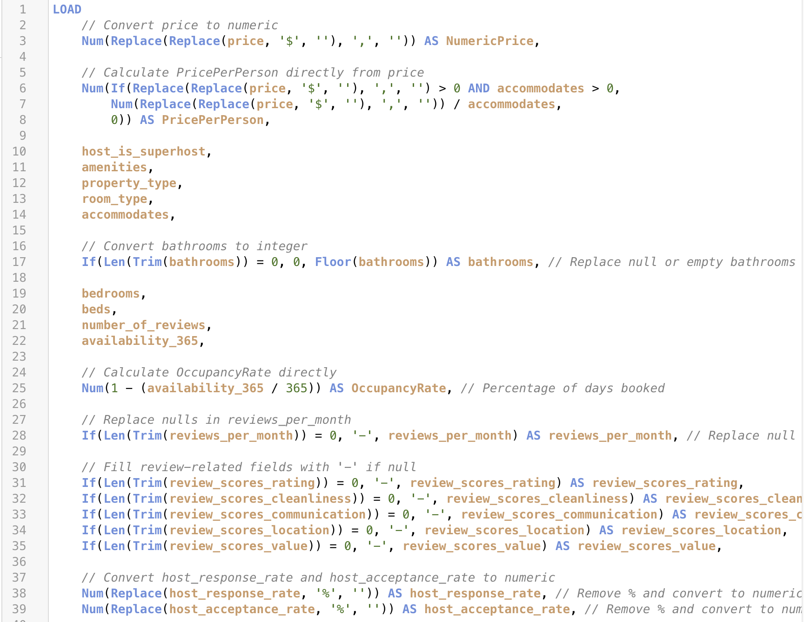
QlikSense Data Load Editor

Slide 7
Feature 1: Dynamic pricing analysis
Goal: help hosts optimize revenue
Problem: find balance between competitive pricing and maximizing revenue
Value: identify trends in demand, variations, and competitor pricing
Key Data Fields: price, amenities, property type, accommodates, host is superhost
Custom Data Fields: value score, price per person, occupancy Rate

Slide 8
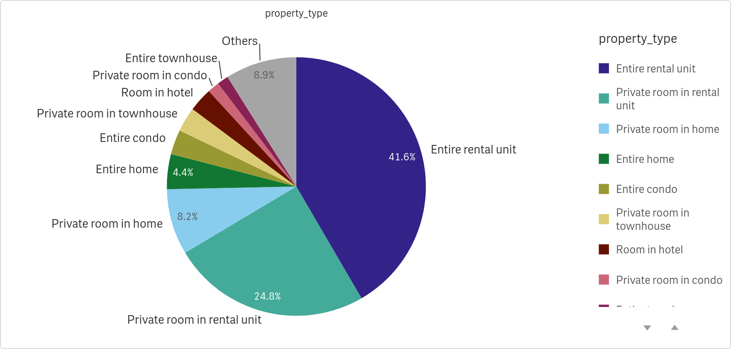
Property Type Distribution

Slide 9
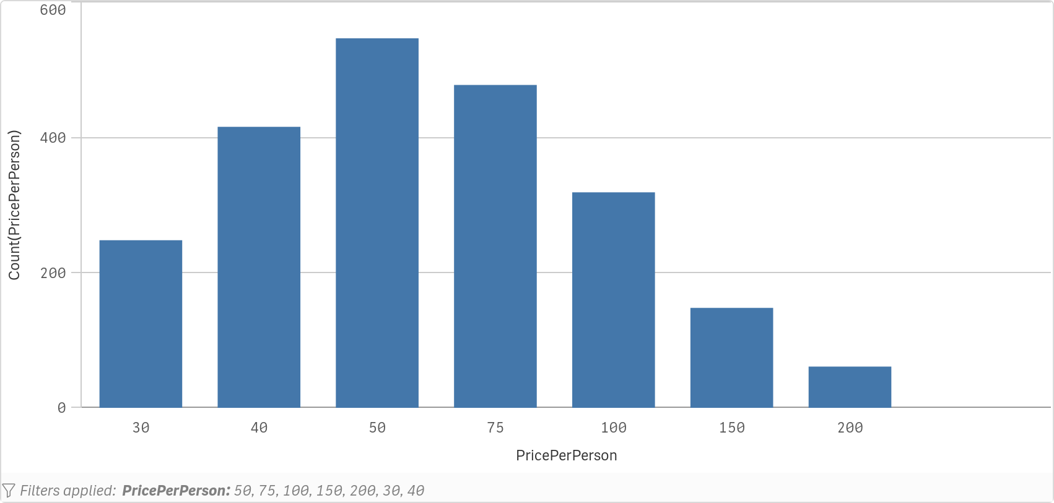
Price Per Person Distribution

Slide 10
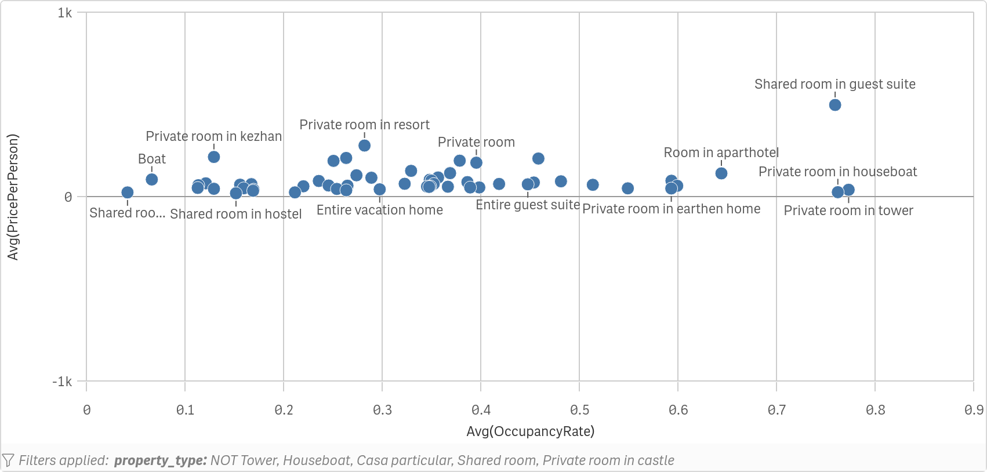
Occupancy vs Price

Slide 11
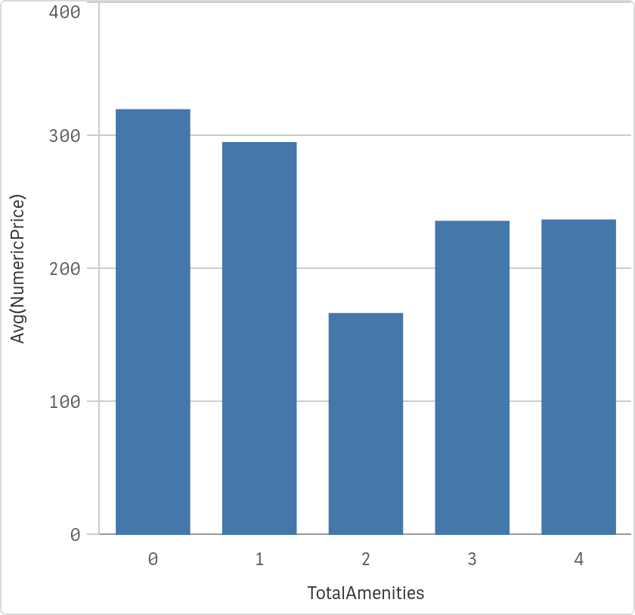
Price vs Amenities

Slide 12
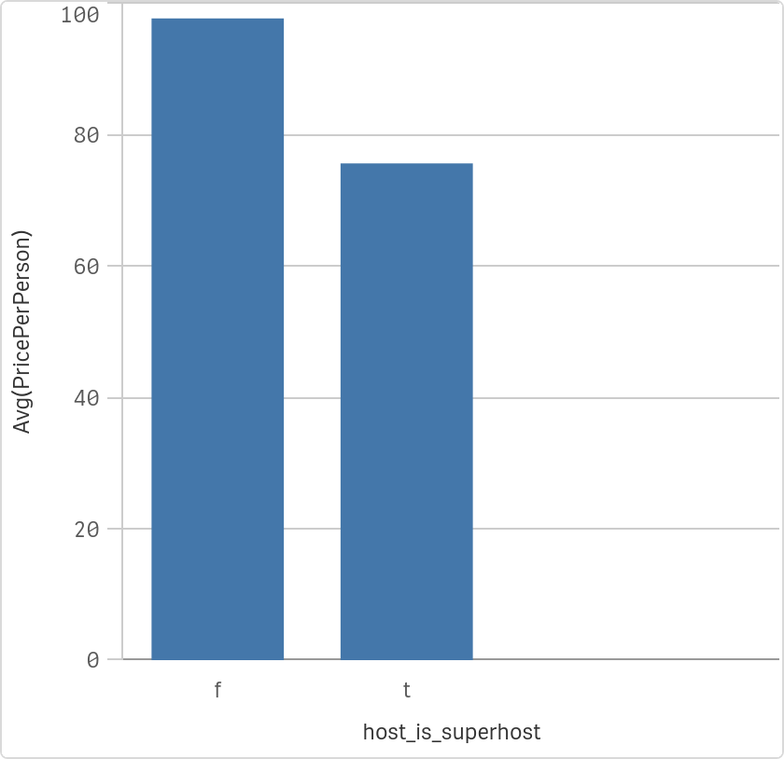
Superhost Impact on Pricing

Slide 13
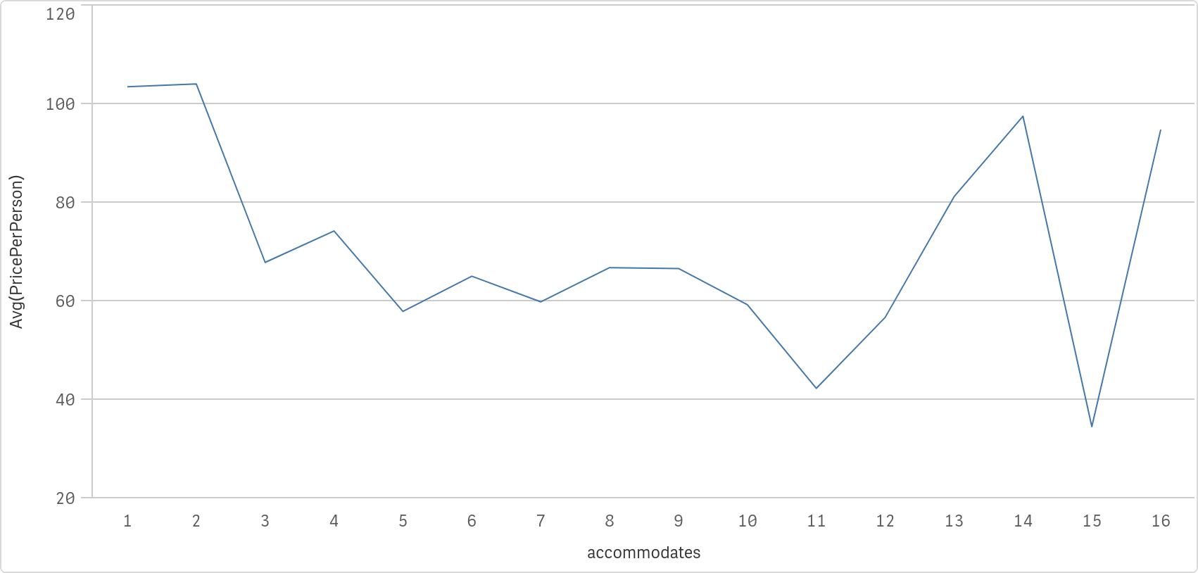
Price Per Person vs Accommodates

Slide 14
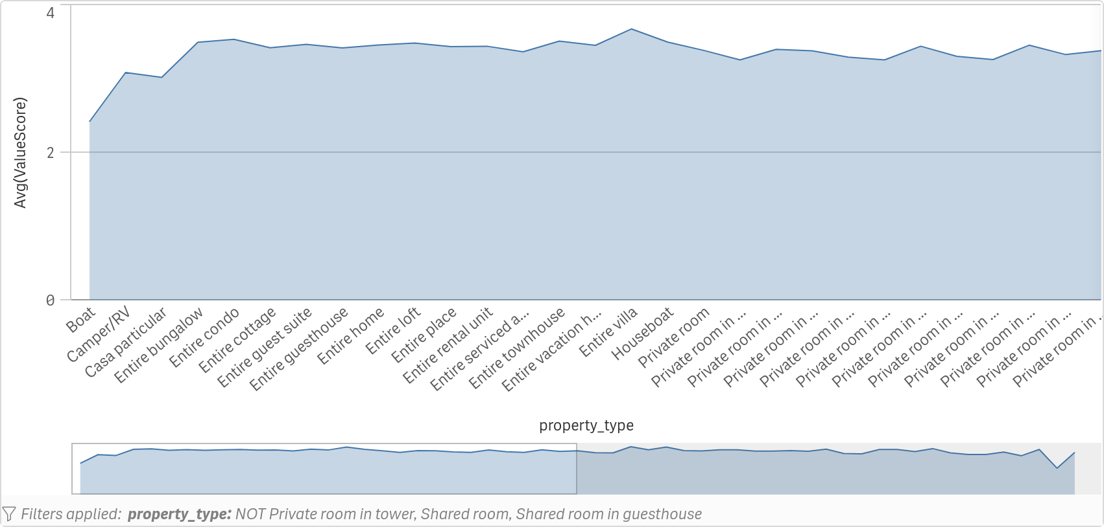
Value Score by Property Type

Slide 15
Feature 2: Listing Visibility
- Problem: What factors influence a listing’s visibility and ranking on Airbnb’s search results?
1
- Value: Enables hosts to improve their listings by focusing on high-impact factors such as high-quality photos, amenities, and review ratings.
2
- ‘Airbnb.csv’: Number of reviews, ratings, amenities, and photos.
3

Slide 16
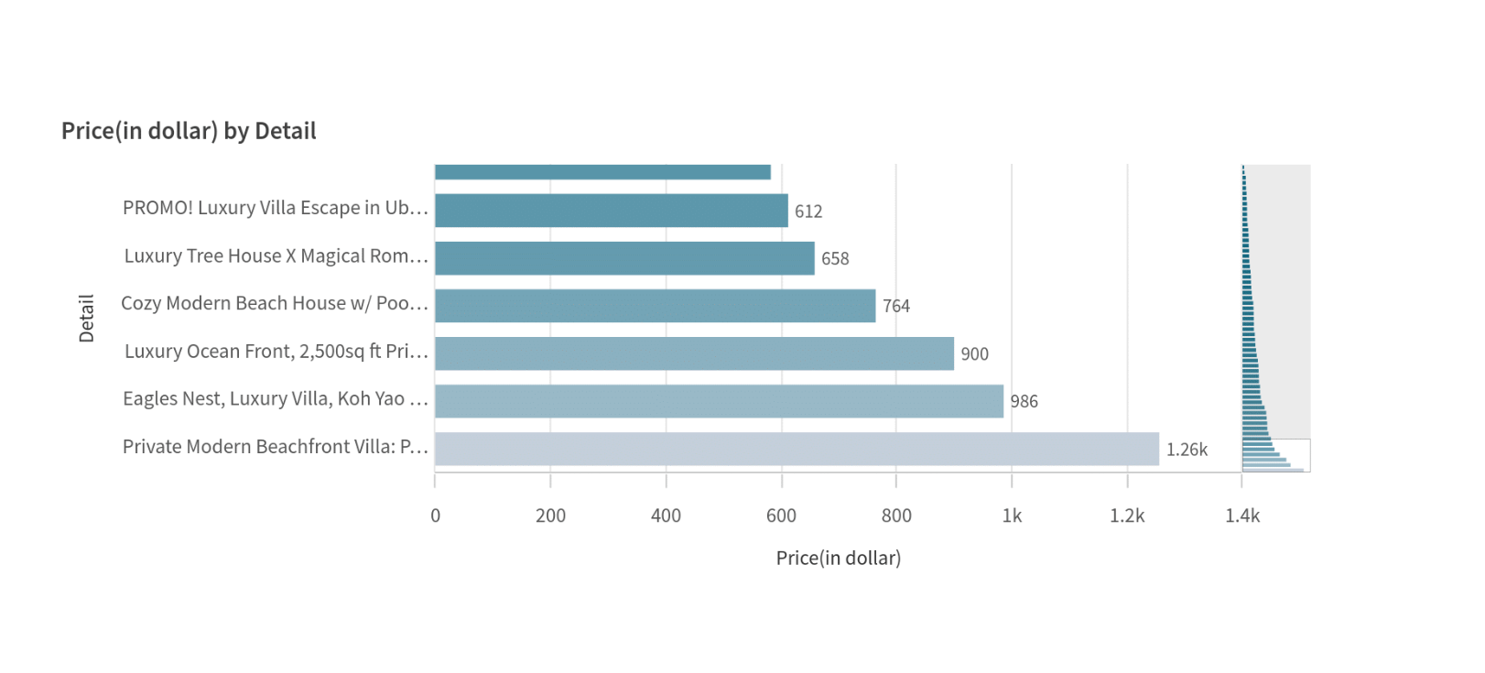
Pricing correlation to Comidities listed in Listing’s Description:
Basic Listings
Vs.
Listings that include words such as “Modern” and “Luxury”

Slide 17
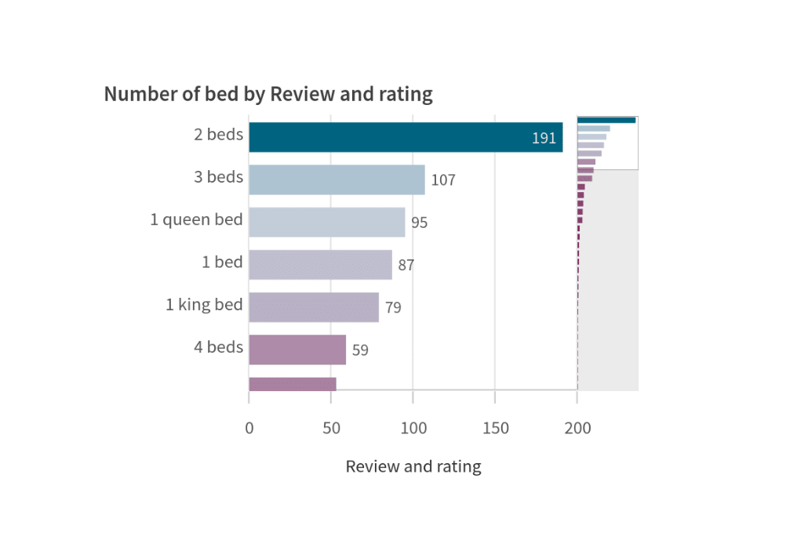
The Impact of Bed Numbers and Types on Pricing and Guest Preferences
Most guests prefer listings with 2 or 3 beds over 1 or 4+ beds

Slide 18
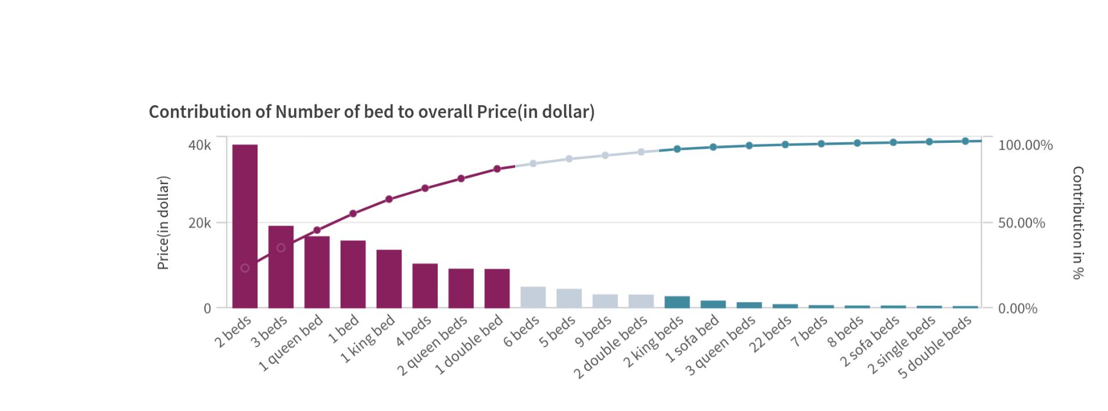
Improvement of Guest Perception by Specifying the Type of Bed:

Slide 19
Feature 3: Targeted Guest Preferences by Neighborhood
Problem: What amenities and features are most popular in specific neighborhoods?
- Value: Helps hosts tailor their offerings based on neighborhood-specific trends, ensuring their properties stand out to potential guests.

Slide 20
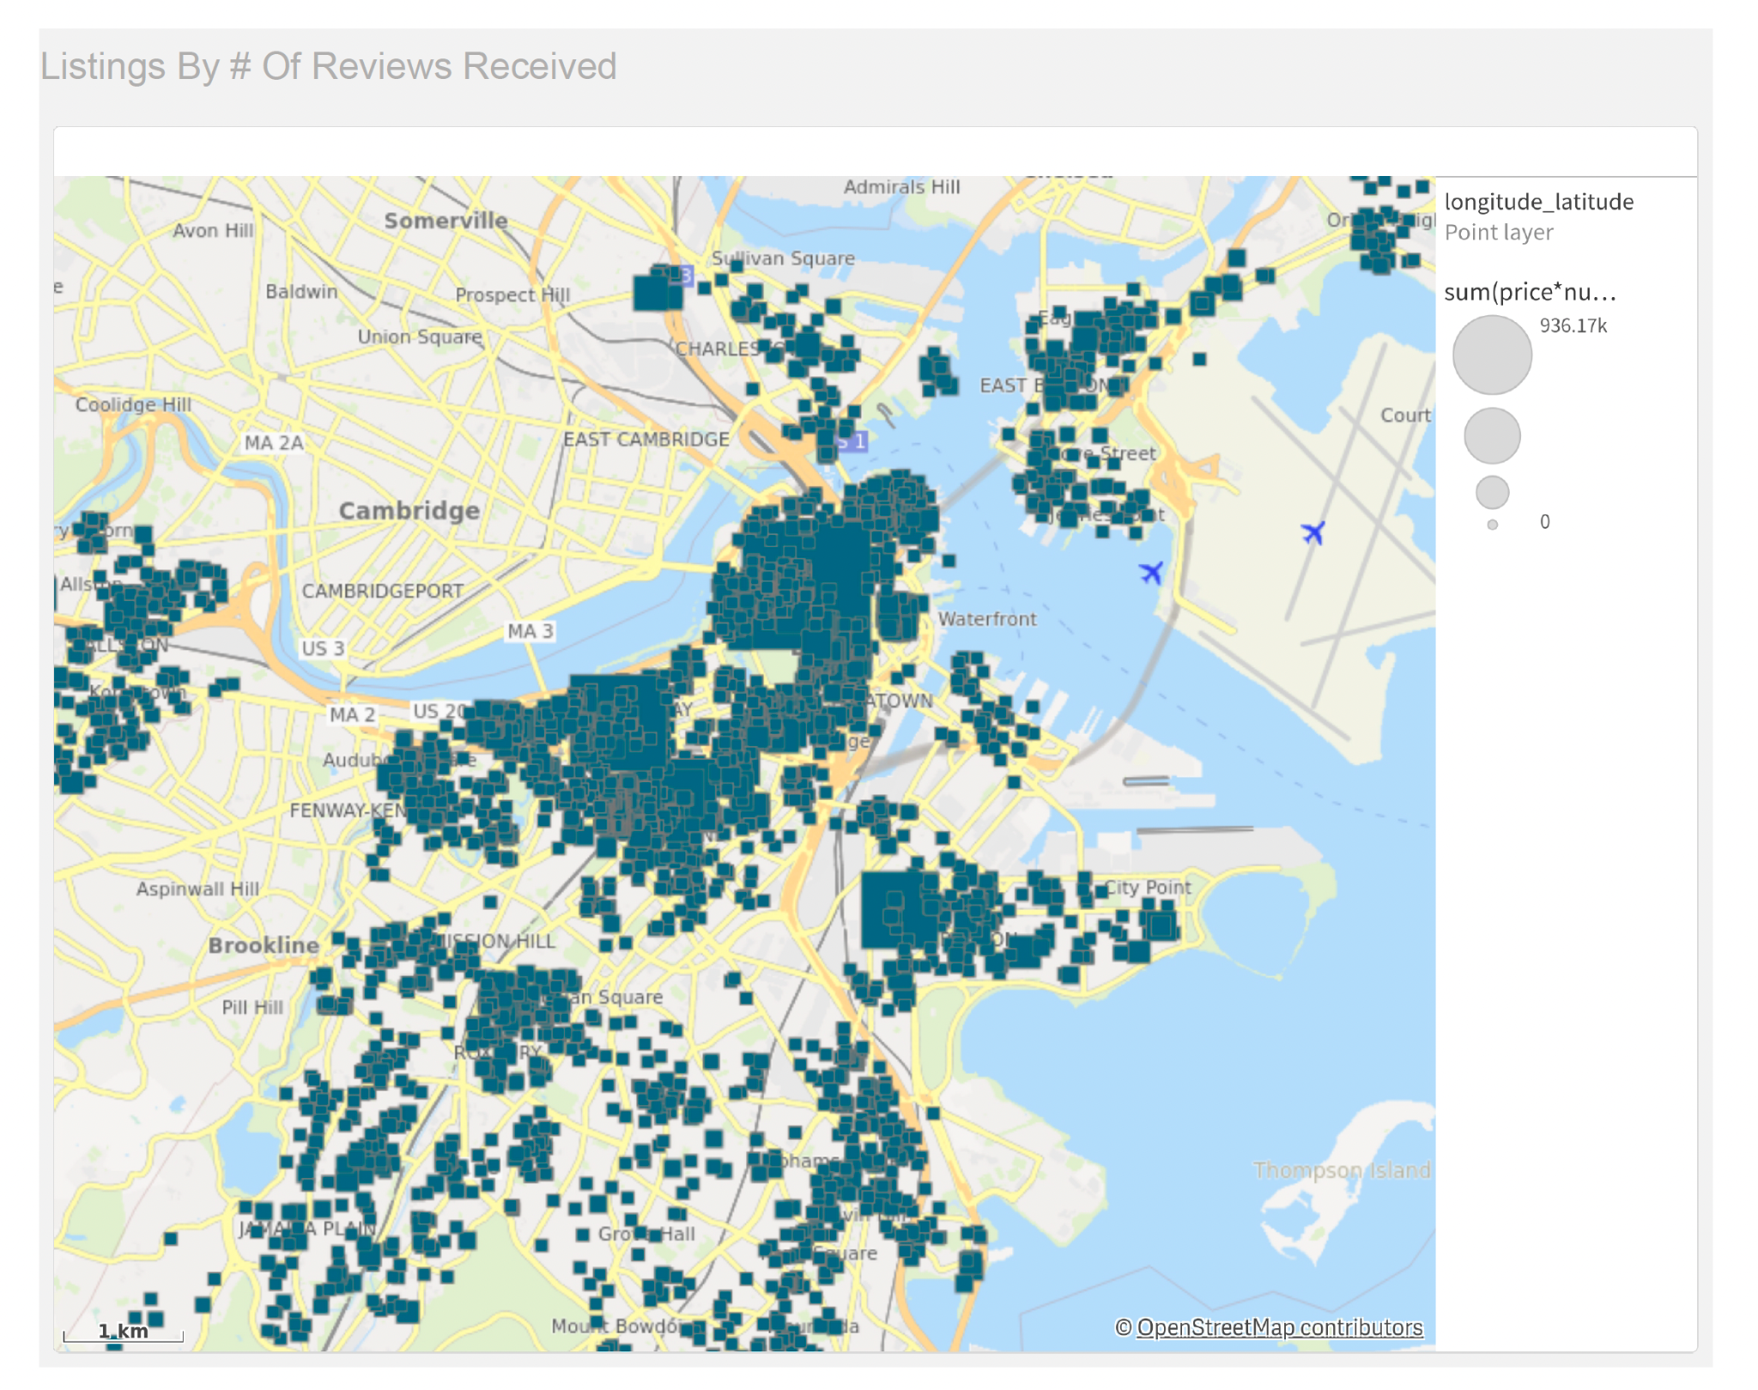
Identifying Popular Neighborhoods for Revenue Maximization:
High Review Neighborhoods
Vs.
Low Reviewed Neighborhoodsc

Slide 21
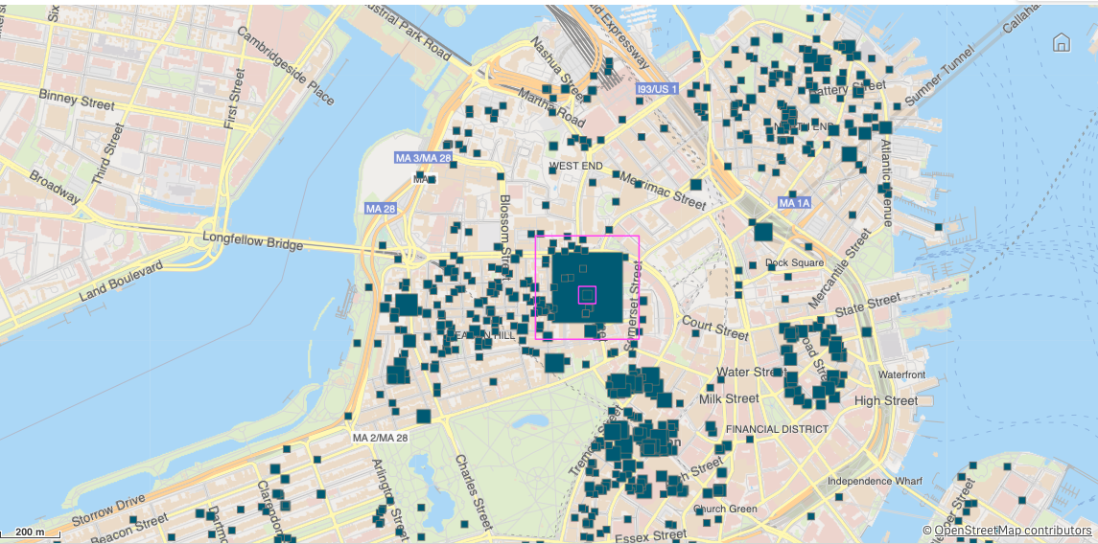
Example Neighborhood: Beacon Hill

Slide 22
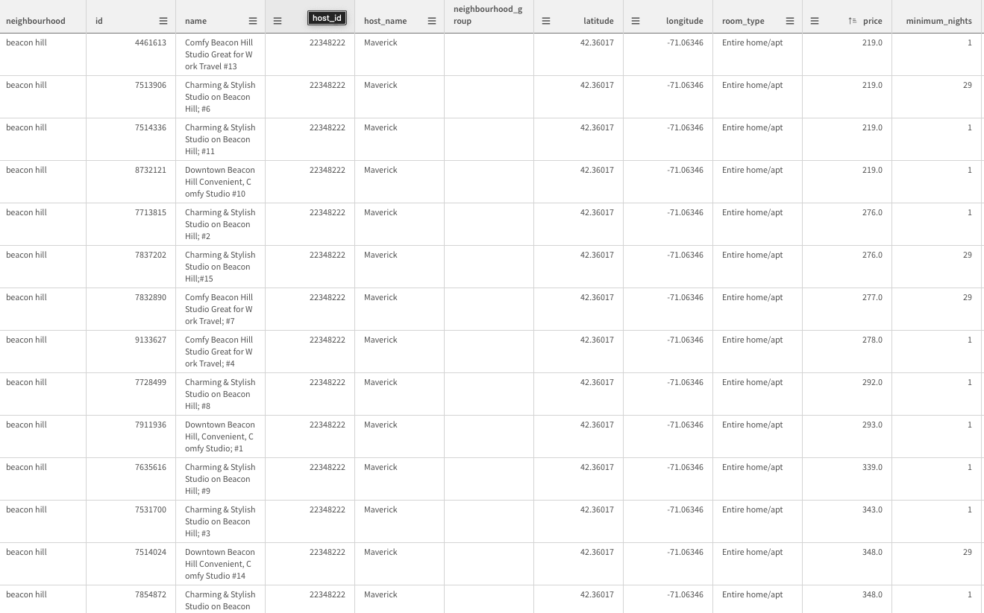

Slide 23
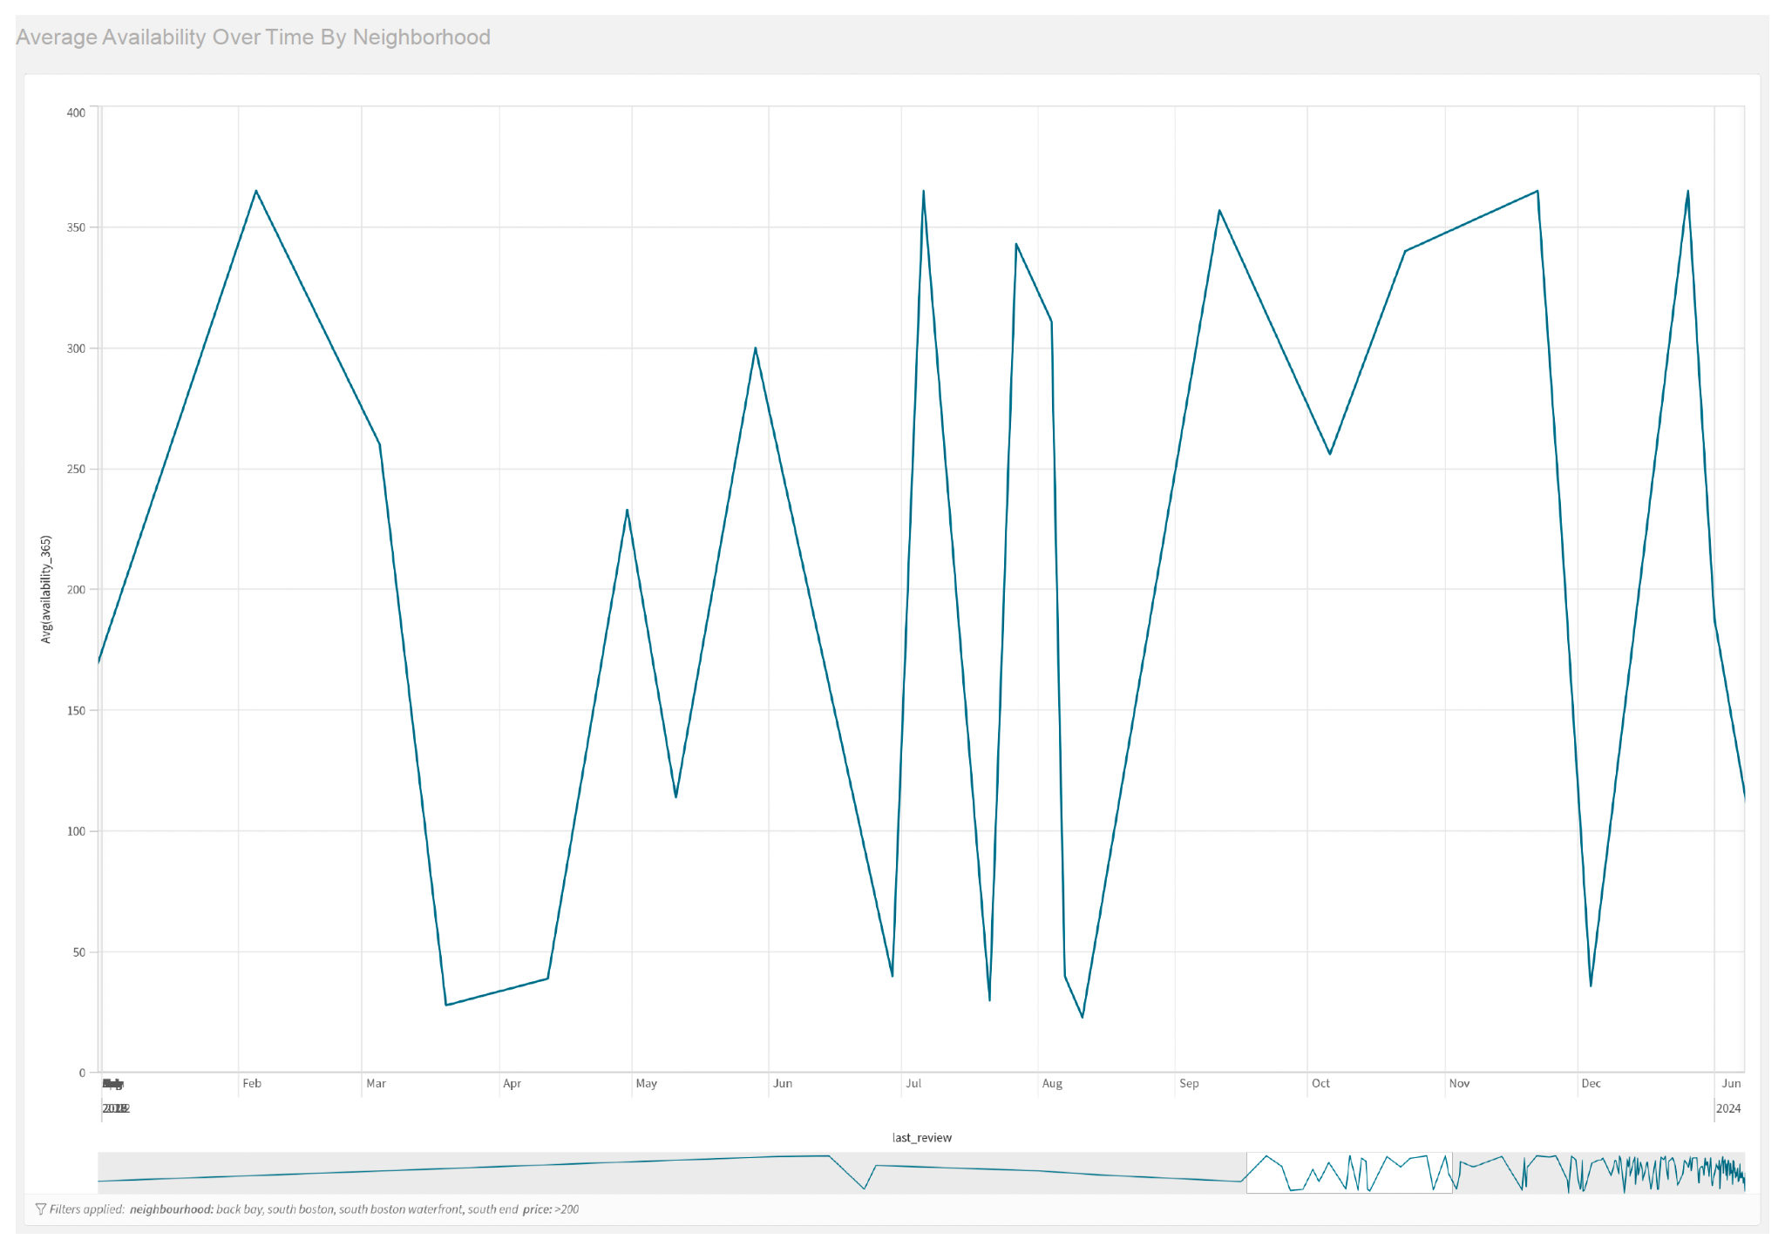
Optimize Seasonal Availability for Better Bookings:
Seasonal Availability Trends
Pricing and Promotional Strategies

Slide 24
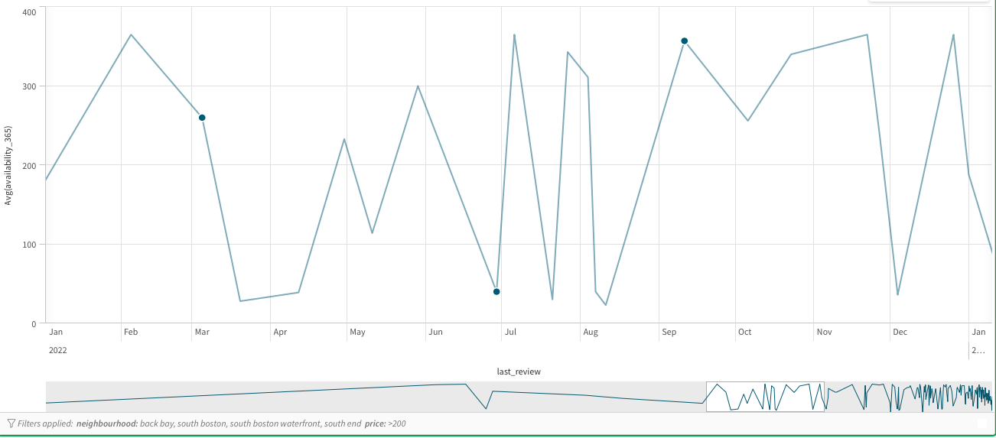
Example Time Period: January 2022 - January 2023

Slide 25
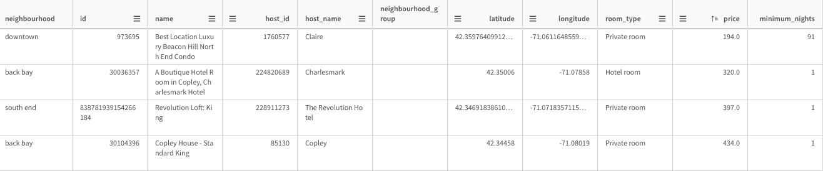
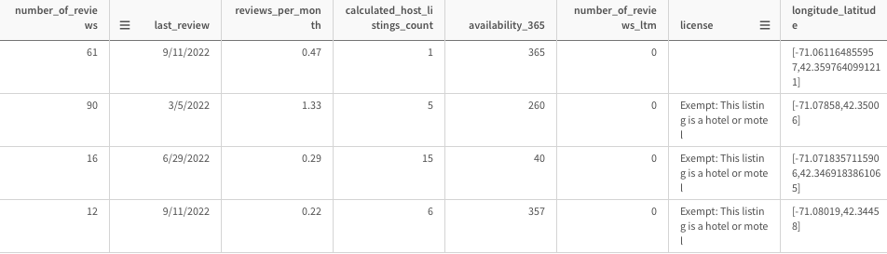
Example Filtering: Neighborhoods (Back Bay, South Boston, South Boston Waterfront, South End) and Pricing ( > 200$ )

Slide 26
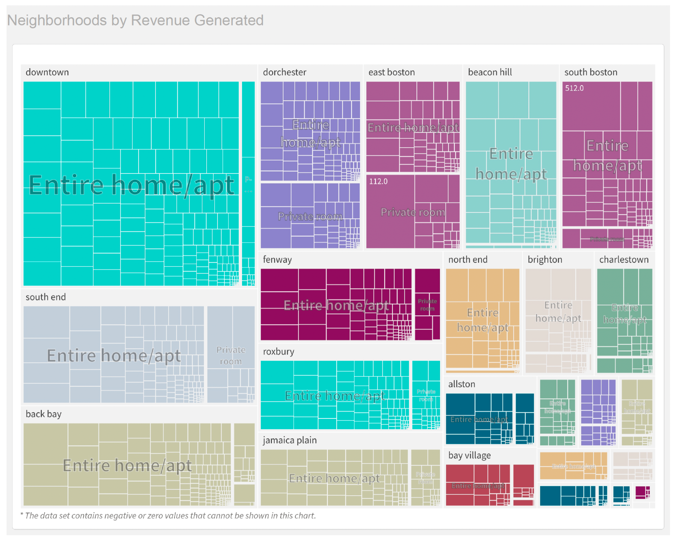
Revenue Potential Across Room Types in Neighborhoods:
Targeted Visibility
Revenue Optimization

Slide 27
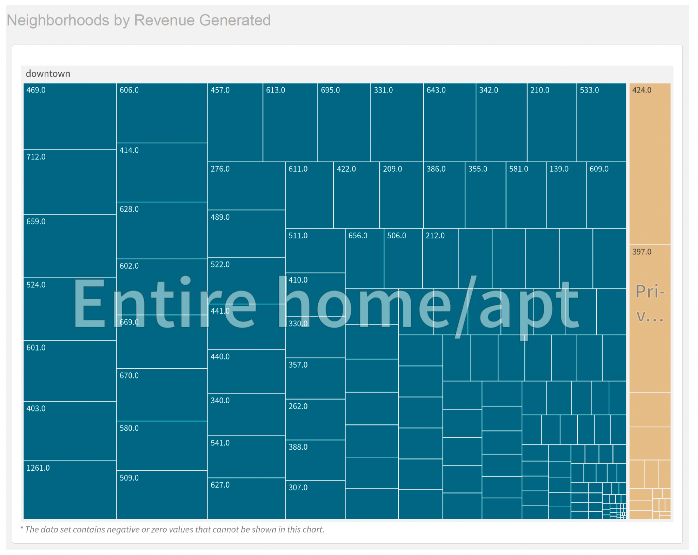
Example: “Downtown” Neighborhood Separated by Room Type

Slide 28
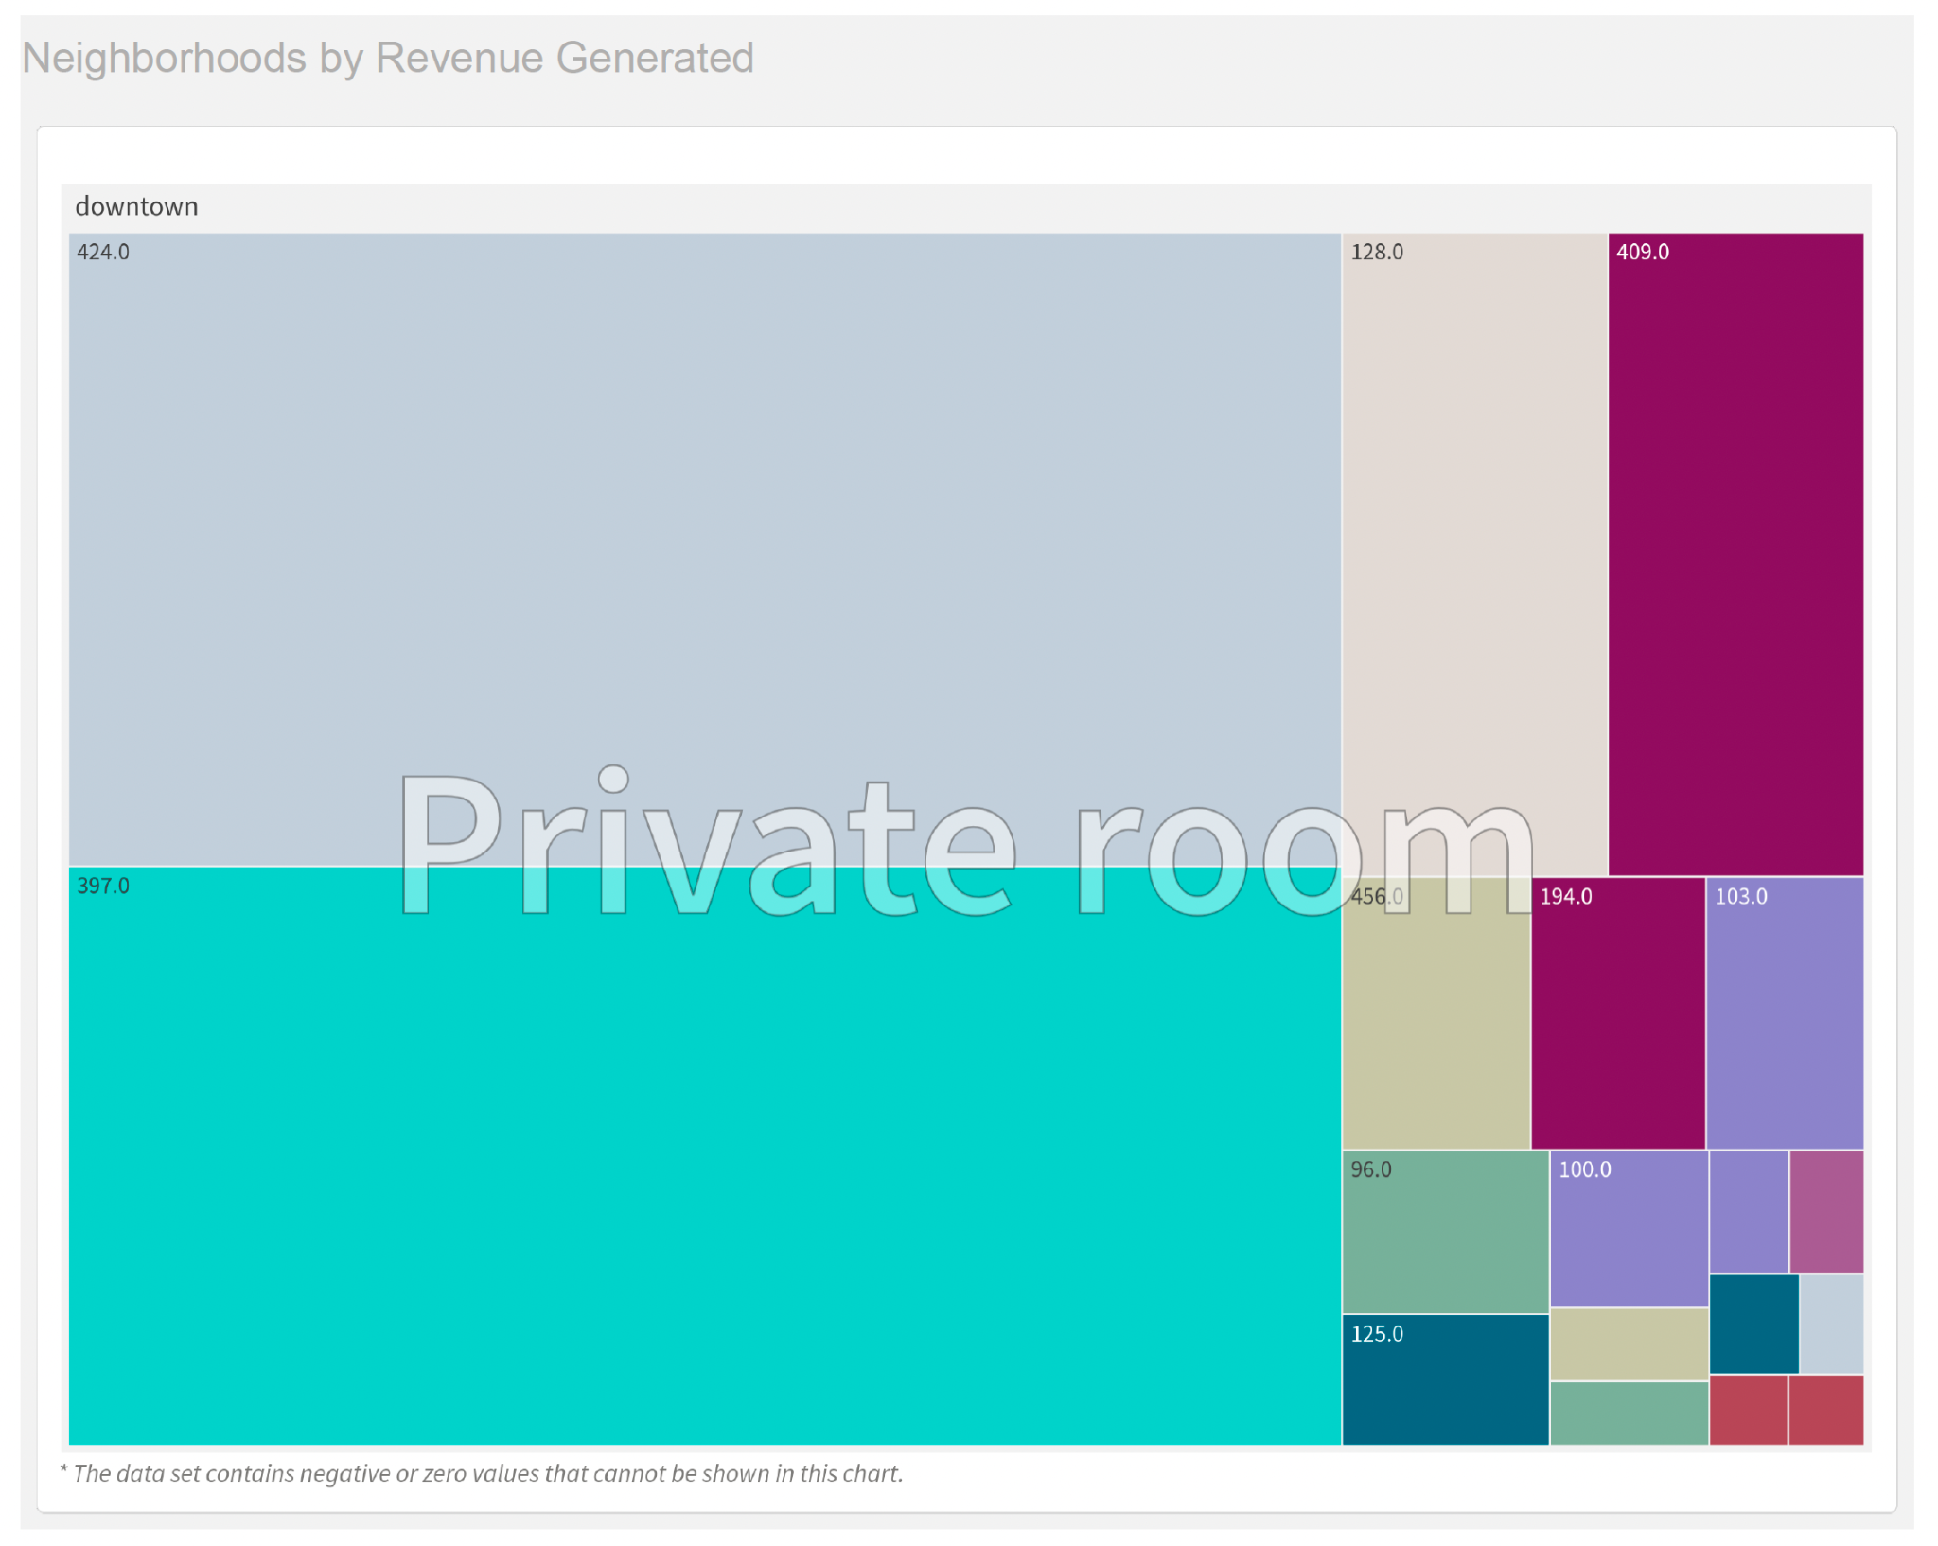
Example: Private Room Listings
Sized by Pricing

Slide 29
How this Helps our Hosts?
With Stay Savvy, Hosts can:
Adjust Pricing based on Demand
Optimize Availability to align with Guest’s Needs
Enhance Visibility by Focusing on the Right Neighborhoods and Room Types
And Benefit by:
Increasing Revenue by Targeting High Demand areas and seasons
Improving Guest Satisfaction by aligning offers with the Guest’s Preferences
Boost Visibility through Data-Driven Marketing and Operational Strategies

Slide 30

Overall, What does Stay Savvy Deliver?
An user-friendly analytics tool for Airbnb hosts that unlocks the full potential of their listings and creates exceptional guest experiences by providing:
Dynamic pricing analysis
Insights into listing visibility
Neighborhood-specific recommendations

